Slide 1
CSE7000 - INTERNSHIP A Presentation on Cybersecurity Internship at InternSpark
Student Details
Name | Prince Kumar
Roll No | 20241CSE0194
Section | 5CSE03
Under the Supervision of,
Ms. Akkamaha Devi and Mr. Vishnu Shankar
Assistant Professor
Presidency School of Computer Science and Engineering
Presidency University
Name of the Program: B. Tech (CSE)
Name of the HoD: Dr. Nagaraja S R
Name of the Program Internship Coordinator: Ms. Vidhya Rengasamy
Name of the School Internship Coordinators: Dr. Bhuvaneshwari Patil

Slide 2
Content
About Company or Organization
Working domain or the Technology
Objectives of the work
Methodology Used / Course Description
Results (Optional)
Conclusion

Slide 3

About Company or Organization
InternSpark is a technology-based training and internship organization that provides students with industry-oriented learning in various technical domains. The company focuses on bridging the gap between academic knowledge and practical industry skills through structured training, hands-on assignments, and mentor guidance.

Slide 4

Key Features
Industry-oriented internship programs
Experienced mentors and trainers
Project-based learning
Regular assessments and feedback
Skill development in emerging technologies
Internship Details
Domain: Cybersecurity
Duration: 1 Month (05 June 2026 – 05 July 2026)
Mode: Online
Learning Model: Practical + Theory

Slide 5
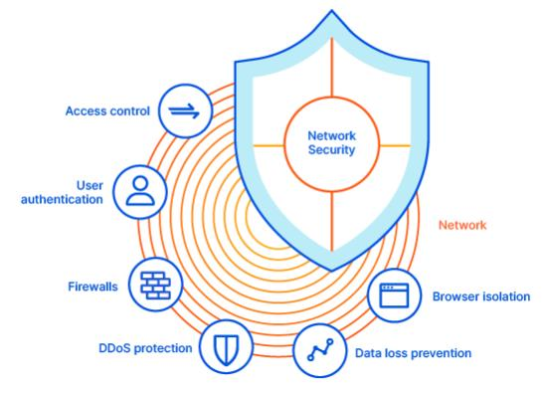
Working domain or the technology
Domain: Cybersecurity
Cybersecurity is the process of protecting computer systems, networks, and digital information from cyber threats, unauthorized access, malware, and data breaches.
Areas Covered
--Network Security --Penetration Testing
--Firewalls --Incident Response
--Security Operations Center (SOC)
--Information Security --Ethical Hacking
--Penetration Testing

Slide 6
Objectives of the work
--The primary objectives of this internship were:
Learn cybersecurity fundamentals.
Understand networking concepts.
Study different cyber attacks and threats.
Learn encryption and cryptography.
Perform vulnerability assessment.
Understand penetration testing.
Learn firewall concepts.
Study ethical hacking.
Understand SOC operations.
Improve technical and communication skills

Slide 7

Methodology Used / Course Description
The internship followed a structured learning methodology consisting of four phases:
Phase 1 – Learning
Cybersecurity Fundamentals
Networking Basics
Security Principles
Phase 2 – Practical Training
Encryption
Firewalls
Vulnerability Assessment
Penetration Testing

Slide 8
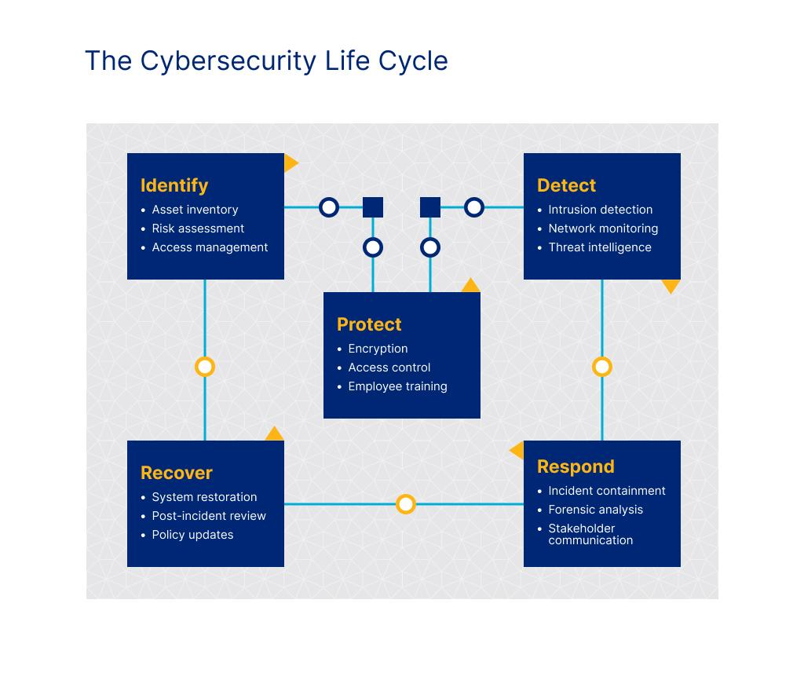
Phase 3 – Assignments
Weekly practical tasks
Case studies
Technical assessments
Phase 4 – Evaluation
Performance review
Final assessment
Report generation

Slide 9
Results
Learning Outcomes
Improved cybersecurity knowledge.
Understood network security concepts.
Learned ethical hacking fundamentals.
Developed analytical and problem-solving skills.
Enhanced technical documentation skills.
Gained industry exposure.
Internship Performance
Overall Score: 91.65%
Grade: A+
Performance: Outstanding

Slide 10
Conclusion
The internship provided valuable practical exposure to cybersecurity concepts and industry practices. It helped me understand the importance of securing computer systems, identifying vulnerabilities, and responding to cyber threats.
Key Achievements
Strong understanding of cybersecurity concepts.
Improved practical and technical skills.
Better problem-solving ability.
Enhanced teamwork and communication.
Increased confidence for future career opportunities.

Slide 11
Q&A

Slide 12
Thank you !!

